Slide 1
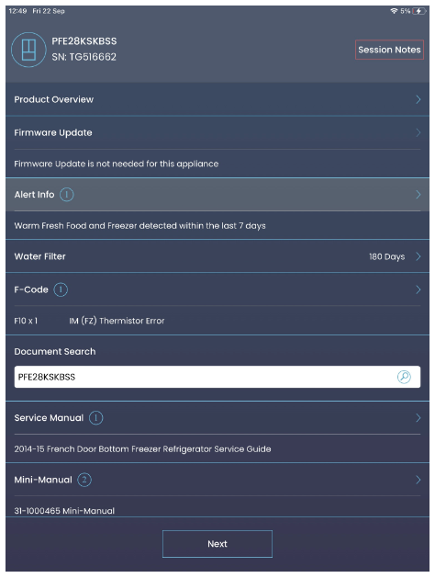
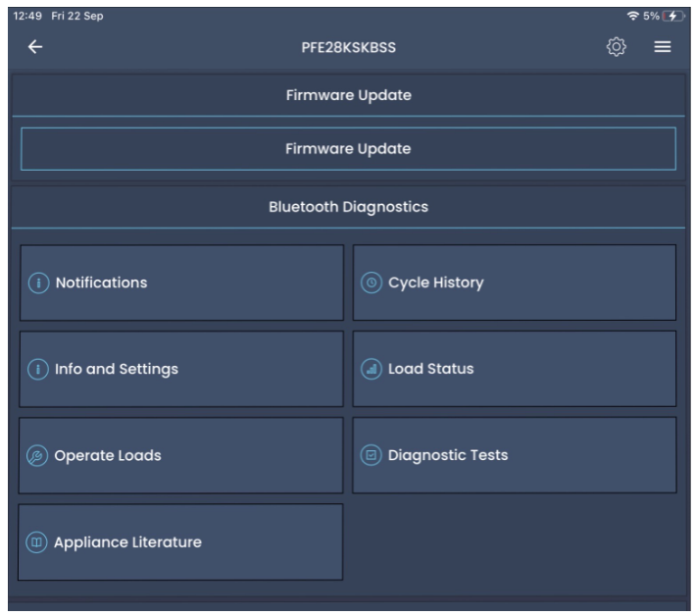
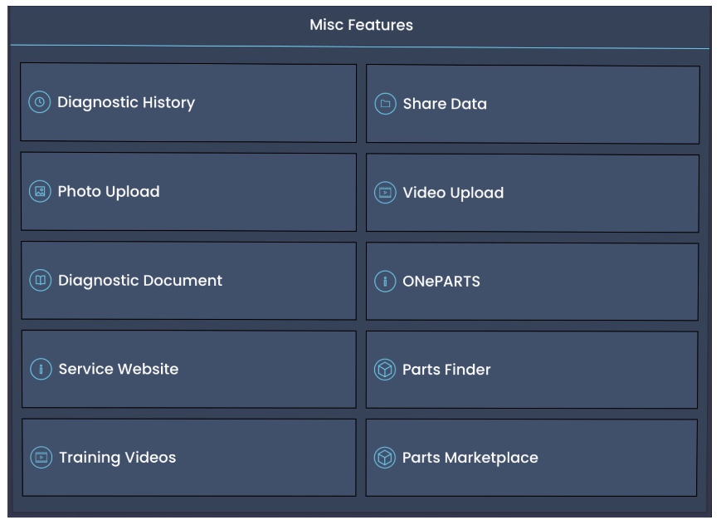
SmartHQ: Current Testing
The Bluetooth module (Navy Bean) is connected with Appliance through RJ 45 connector.
SmartHQ APP (Android / iOS) connect with Bluetooth module through Bluetooth,
Upon successful pairing, the model gets detected and the specific menu in the app will get displayed.
The testing is conducted for
Regression Testing : Testing of every feature in the app.
Firmware update: downgrade or upgrade the firmware in the appliances
Forced fault code testing : Simulate fault in appliance and verify it through app.
10

Slide 2
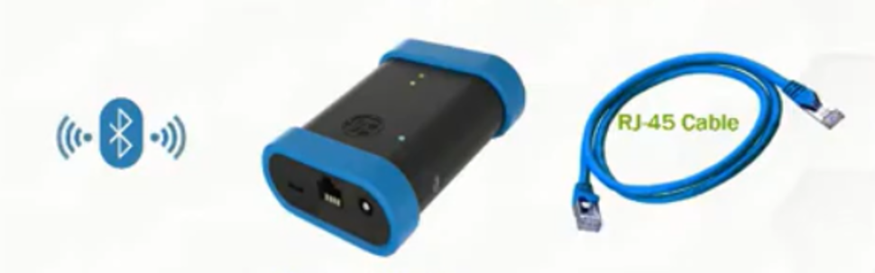
Potential Test Setup
Automation
Test Criteria
Interface Library
Common Response Library
Device A
Model
Device B
Model
Device N
Model
PC – Running Appliance Models
Simple models for each Appliance
Simulate errors/success
Multi Appliance Testing
Inject Errors

